Slide 1

Fitness class booking system

Slide 2

TEAM NAME:PYTHONISTAS
NAME:SONALI SANGAMESH MUDALAGI
USN:3BR22CS165
NAME:SHALU KUMARI
USN:3BR22CS153
NAME:TRISHA PRAMEELA Y
USN:3BR22CS174
NAME:SHASHIKALA J
USN:3BR22CS154

Slide 3



Abstract
Fitness class booking system consists of two main classes: fitness class and fitness class manager.
Fitness class:
Represents an individual fitness class with attributes like class ID, class name, maximum capacity, and a dictionary to store bookings.
Provides methods to add bookings (add_booking), cancel bookings (cancel_booking), and retrieve bookings (get_bookings).
Fitness class manager:
Manages multiple fitness classes by storing them in a list.
Offers (crud operations) functionality to add a new fitness class (add_class), delete an existing class (delete_class), update class details such as name and capacity (update_class), and retrieve a list of all class names (display_classes).

Slide 4

Allows managing bookings for fitness classes (manage_fitness_class_bookings) by booking or canceling slots for users.
Tracks class attendance (track_class_attendance) by counting the number of bookings for each class.
Provides a method to retrieve booking details for a specific class (get_class_details).
UNITTEST:
The code includes a set of unit tests (TestFitnessClassBookingSystem) using the unittest framework to ensure the correctness of the implemented functionalities.
These tests cover adding, deleting, and updating classes, managing bookings, tracking attendance, and retrieving class details.

Slide 5

introduction
In this Project:
Fitness classes are represented as objects with attributes like class ID, name, and maximum capacity.
The FitnessClassManager class manages multiple fitness classes, providing functionalities to add, delete, and update class details.
Users can book or cancel bookings for classes, with the system tracking attendance by counting the number of bookings.
The code includes unit tests to ensure the correctness of system functionalities, covering scenarios such as adding/deleting classes, booking/canceling bookings, tracking attendance, and displaying class information.

Slide 6

MODULE DESCRIPTION
FitnessClass Class
_init_(self, class_id, class_name, max_capacity)
Purpose: Initializes a FitnessClass object with the provided parameters.
Parameters:
class_id: Unique identifier for the fitness class.
class_name: Name of the fitness class.
max_capacity: Maximum capacity of the fitness class.
add_booking(self, user_id)
Purpose: Adds a booking for a user to the fitness class if there's available space.
Parameters: user_id: Identifier for the user booking the class.
Returns: True if the booking was successful, raises ValueError otherwise.
cancel_booking(self, user_id)
Purpose: Cancels the booking for a user from the fitness class.
Parameters:
user_id: Identifier for the user whose booking is to be canceled.
Returns: True if the booking was successfully canceled, raises ValueError otherwise.

Slide 7
get_bookings(self)
Purpose: Returns the dictionary of bookings for the fitness class.
Returns: Dictionary containing user bookings.​
FitnessClassManager
Class_init_(self)
Purpose: Initializes a FitnessClassManager object with an empty list of classes.
add_class(self, fitness_class)
Purpose: Adds a fitness class to the manager's list of classes.
Parameters:
fitness_class: FitnessClass object to be added.
Returns: True if the class was added successfully.
delete_class(self, class_id)
Purpose: Deletes a fitness class from the manager's list of classes.
Parameters: class_id: Identifier of the class to be deleted.
Returns: True if the class was deleted successfully, raises ValueError otherwise.

Slide 8
update_class(self, class_id, new_class_name, new_max_capacity)
Purpose: Updates the details of a fitness class.
Parameters: class_id: Identifier of the class to be updated.
new_class_name: New name for the class.
new_max_capacity: New maximum capacity for the class.
Returns: True if the class was updated successfully, raises ValueError otherwise.
manage_fitness_class_bookings(self, class_id, user_id, action)
Purpose: Manages bookings for a fitness class (booking or canceling).
Parameters: class_id: Identifier of the class to manage bookings for.
user_id: Identifier of the user performing the action.
action: Action to perform ("book" or "cancel").
Returns: True if the action was successful, raises ValueError otherwise.
track_class_attendance(self)
Purpose: Tracks the attendance for all fitness classes managed by the manager.
Returns: Dictionary containing class IDs as keys and the number of bookings as values.

Slide 9
display_classes(self)
Purpose: Displays the names of all fitness classes managed by the manager.
Returns: List of class names.
get_class_details(self, class_id)
Purpose: Retrieves details of bookings for a specific fitness class.
Parameters: class_id: Identifier of the class to retrieve details for.
Returns: Dictionary containing user bookings for the specified class, raises ValueError if the class is not found.
UNITTEST CASES
test_add_class:
Purpose: Tests the addition of a new fitness class to the manager.
Checks if a class is successfully added and the number of classes in the manager increases.
Verifies that an error is raised when attempting to delete a non-existing class.
test_delete_class:Purpose: Tests the deletion of a fitness class from the manager.
Validates whether a class is correctly deleted, reducing the number of classes in the manager.
Ensures that an error is raised when attempting to delete a non-existing class.

Slide 10
test_update_class:
Purpose: Tests the update of class details such as name and maximum capacity.
Validates if the class details are successfully updated.
Verifies that an error is raised when attempting to update details of a non-existing class.
test_manage_fitness_class_bookings:
Purpose: Tests the booking and canceling of class bookings.
Checks if bookings and cancelations are processed correctly.
Verifies that errors are raised for invalid actions or non-existing classes.
test_track_class_attendance:
Purpose: Tests the tracking of class attendance.
Validates if the attendance data is accurately recorded. Ensures that the attendance count is updated based on bookings.
test_display_classes:
Purpose: Tests the display of class names. Validates if the names of all classes managed are correctly returned.
test_display_class_details:
Purpose: Tests the display of booking details for a specific class. Validates if the booking details for a class are accurately retrieved.

Slide 11
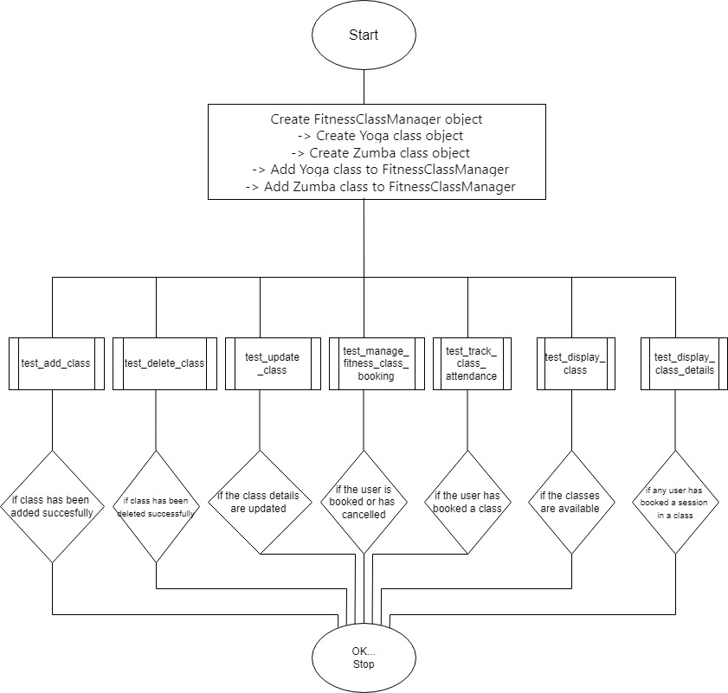
flowchart

Slide 12

Source code

Slide 13
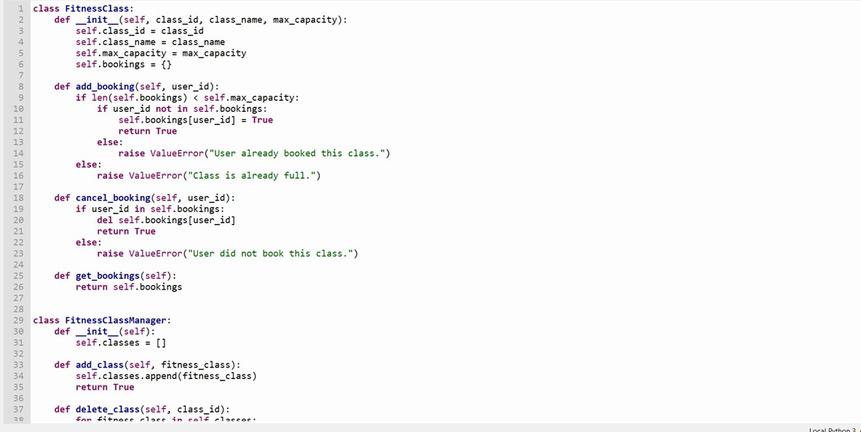

Slide 14
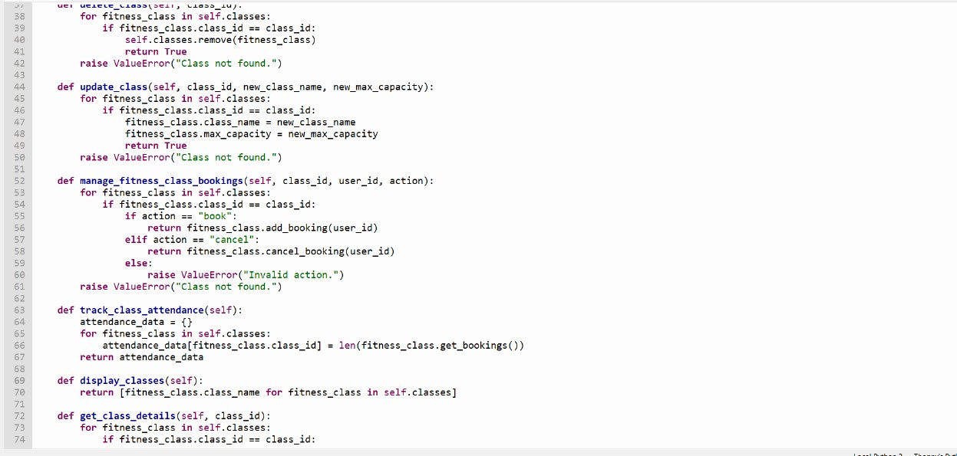

Slide 15
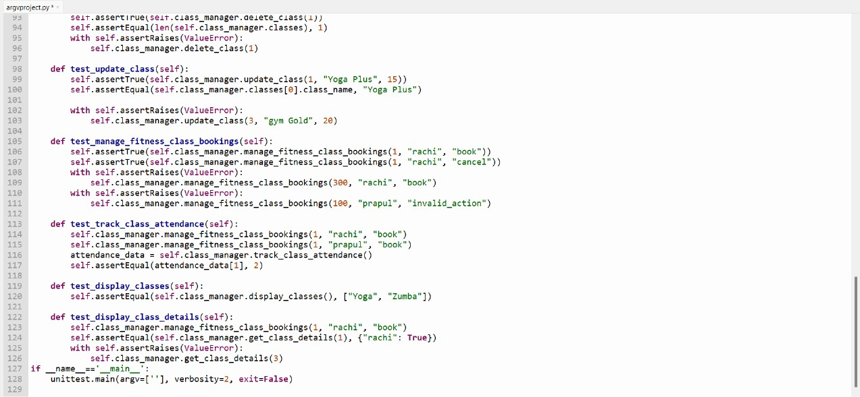

Slide 16
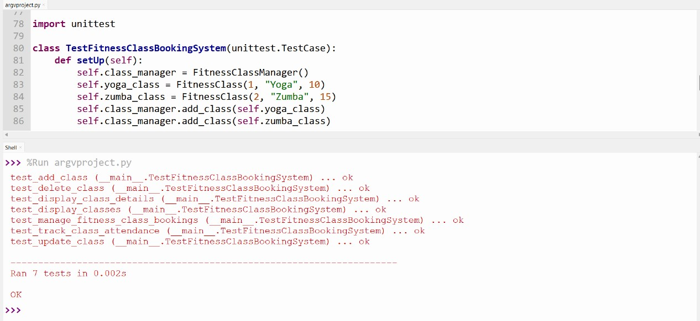

Output

Slide 17

Summary
This code creates a program for managing fitness classes for Yoga/Zumba.
It allows Yoga/Zumba staff to add, remove, and update classes.
Users can book and cancel their attendance for these classes, and the system keeps track of how many people attend each class.
Additionally, the code includes tests to make sure everything works correctly.
Overall, it's a handy tool for organizing and tracking fitness classes and attendance.

Slide 18
bibliography
Google Chrome
Chatgpt
www.programiz.com
https://docs.python.org/3/library/unittest.html
Github link
https://github.com/Sonalismudalagi/BITMS
https://github.com/ShashikalaJ/BITMS
https://github.com/3sha1234/BITMS
https://gitHub.com/kimshalu/BITMS

Slide 19

Thank you
BY TEAM PYTHONISTAS

